Slide 1
B8-01 Alpha Particle Identification
Candidate Number: 1073415

Slide 2


Rutherford Scattering: The Data

Slide 3
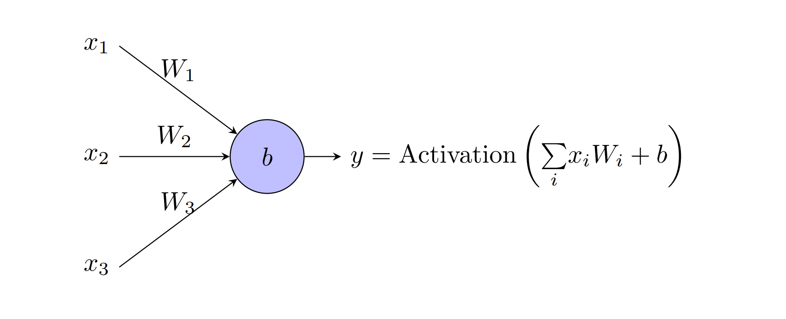
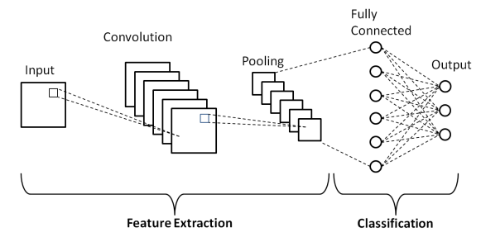
A Machine Learning Approach
Machine learning aims to automate complex tasks by approximating their solution using data.
Principle is the same but different tasks require different model architectures.
My model comes from testing and iterating, starting very simple and adding features that improved performance.
Y. H. Teoh. Machine learning and optimization
techniques for trapped-ion quantum simulators.
Master’s thesis, University of Waterloo, 2020.
A. Abdelrahman and S. Viriri. Kidney tumor semantic
segmentation using deep learning: A survey
of state-of-the-art. Journal of Imaging, 8:55,
02 2022.

Slide 4
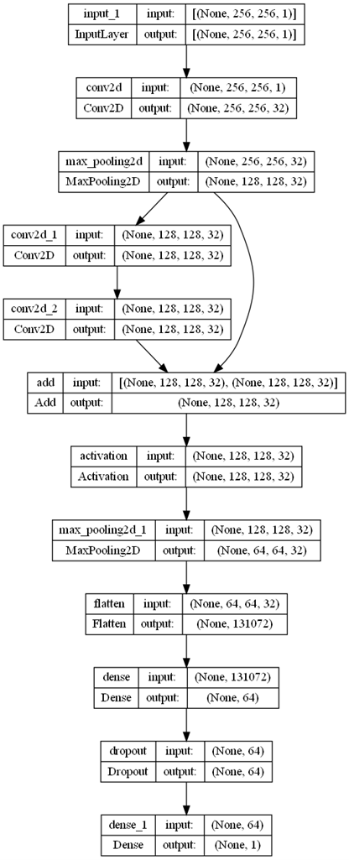
The Model
Input: 256x256 single channel image
Output: Single number count (rounded)
Three convolutional layers with 32 filter
Max Pooling to reduce spatial dimensions
One Residual Module
One fully connected layer with dropout between flattening and output

Slide 5
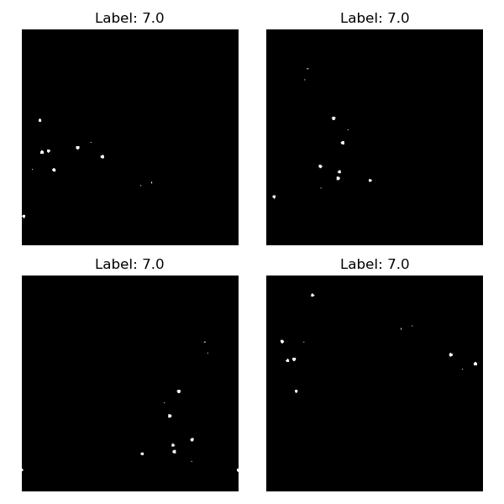
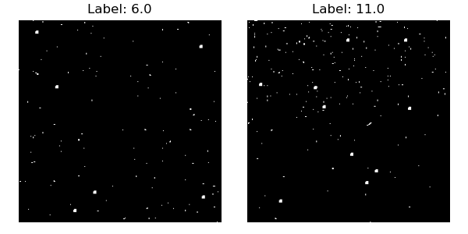
Augmented Data
Synthetic Data
Images are also pre-processed using a threshold to set all values to 1 or 0 with the aim of eliminating noise, and increasing the model’s dependence on alphas’ shape rather than overall brightness

Slide 6
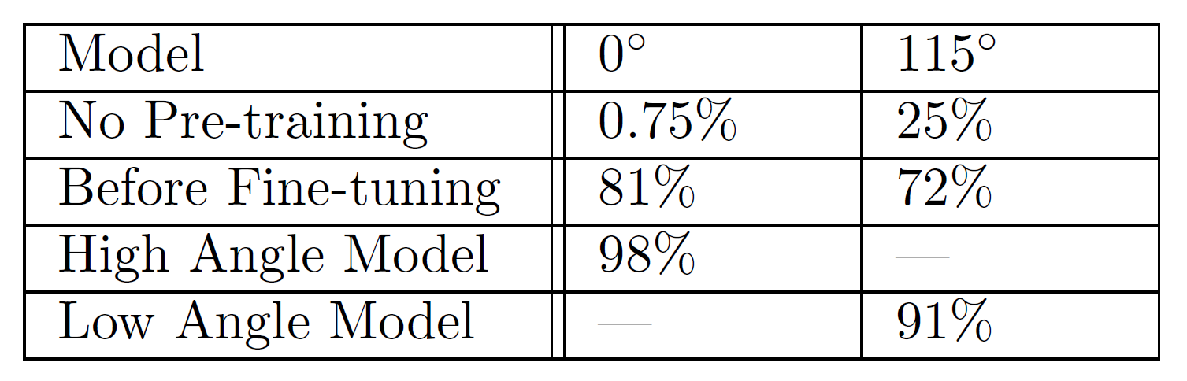
Training the Model
Pre-training on synthetic data clearly transfers well to real data
This is improved further by fine-tuning with real dataset, increased in size by data augmentation
Low angle metric is total count comparison, high angle is individual photo accuracy

Slide 7
The Problem with High Angle Images
High angle images have very few alphas, ~10-20 in 400 images
Unlike low angles where undercounting can balance out overcounting, there are very few images where it is possible to undercount
Even though accuracy (number of photos where count is correct) is >90%, the predicted count can easily be many times the actual count.
Issue can be reduced by manually checking the images the model claims has alphas to improve accuracy, but then always get undercounting
Also need to finetune to ensure it does not massively over-count while still actually finding real alphas
Question of how to evaluate the model’s performance is complex, especially as outputs are rounded:
With a working model, could evaluate a root mean squared error per image to give total error based on number of photos predicted on.
But this will give much larger uncertainties than reality – especially for low angle images

Slide 8
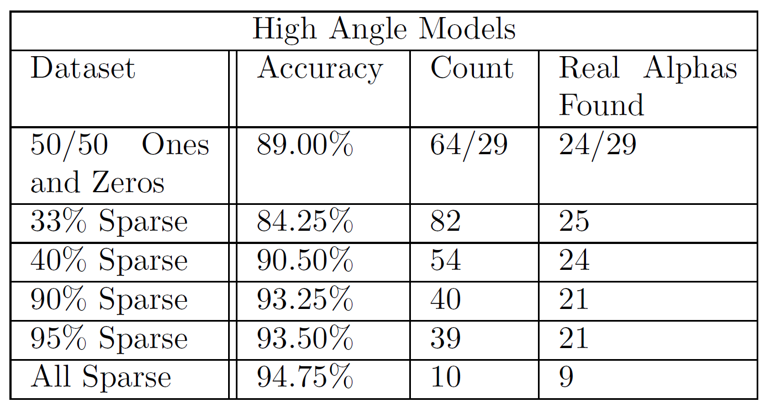
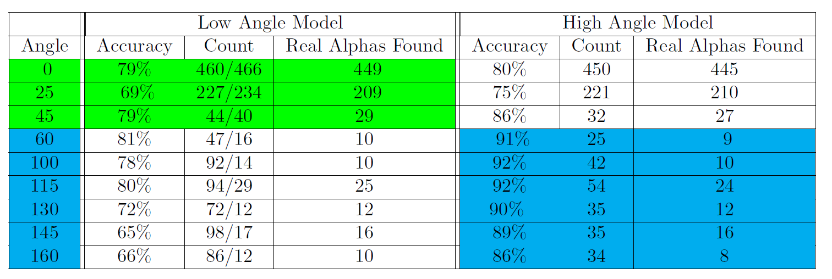
Testing
Tested different high angle datasets for finetuning the high angle model
Tested final models on a range of angles to determine which worked best at each angle

Slide 9
Results
98.8% count accuracy across 385 low angle images with 740 alphas
Found 79 of 100 real alphas in 1900 high angle images but outputted a count of 209
Struggles when exposure changed – not robust

Slide 10
Summary
Not enough training data
Data Augmentation
Data distributions affecting predictions
Synthetic data
Model sensitive to image brightness
Binary Preprocessing
High Angle images difficult for model
Manually check images predicted to have alpha
Persistent issues:
Sensitivity to brightness
Robustness across different camera settings
High Angle Images

Slide 11
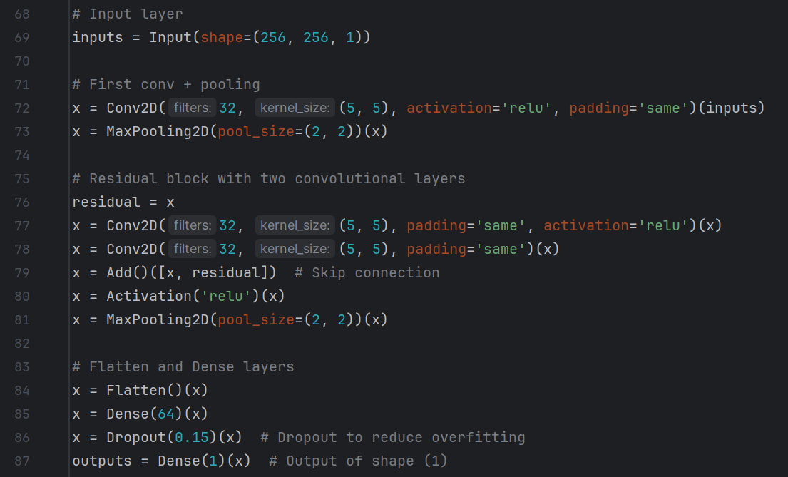
Thank you for listening

Slide 12
Conclusions – Why is this data difficult for the model?
Model doesn’t perform as well as might have expected, despite efforts in architecture design and training – why is this?
Large variation – model struggles with changes in camera setting, standardising data collection could lead to improvements
High angle images – difficult as discussed
Sparsity – searching for ~10 bright pixels in >10^4 pixels where almost all are 0 is difficult for CNNs, generally looking for large patterns across image

Slide 13
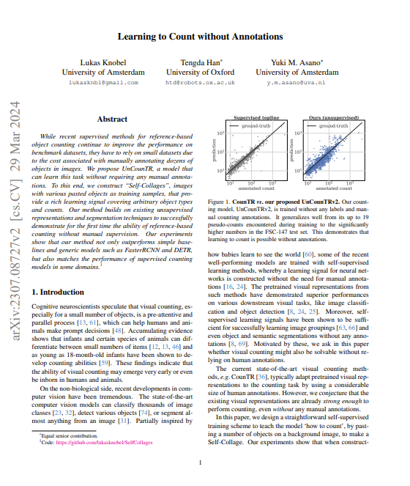
Improvements
Model itself is likely also not very well suited to the task, tried many ideas which did not improve performance
Localising the alphas in the images could decrease dependence on overall brightness, by labelling data for this is time consuming
L. Knobel, T. Han, and Y. M. Asano. Learning to count without annotations. (In Proceedings of the IEEE/CVF Conference on Computer Vision and Pattern Recognition, pages 22924–22934, 2024.) gives architecture which could be adapted to train a model to localise alphas without need to label many images
https://arxiv.org/pdf/2307.08727

